Slide 1


Secure your RestApp
An Engine of Application State

Slide 2
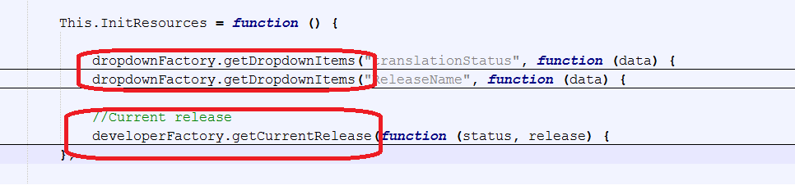
Issues to solve :
Descriptive binding : Potential security breach
$stateProvider
.state("admin",
{
url: "/adminactivity",
templateUrl: configurationConstants.TEMPLATES_PATH.admin_activity_html,
controller: "adminController",
controllerAs: "vm"
})
Pleonastic logic flow : amateur code

Slide 3
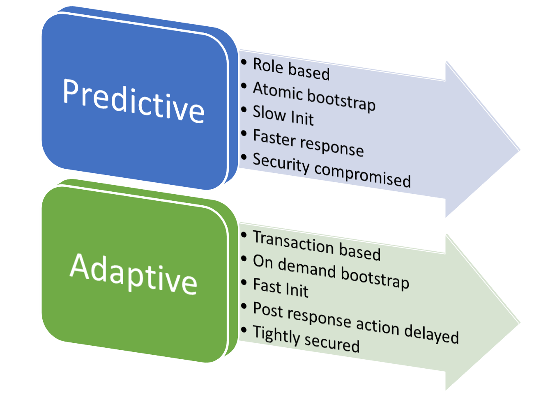
Approaches :

Slide 4
Predictive | Adaptive
{ "apiIndex": { "Action": [ { "-name": "LIST_CUSTOMER", "-description": "List all the Customers", "link": { "apiID": "LIST_CUSTOMER", "description": "List All the Customers", "href": "https://c0039836.itcs.hp.com/api/v1/customers", "type": "GET" } }, { "-name": "CHANGE_BILLING_MODEL", "-description": "Change the billing model and refresh proposal price", "link": [ { "apiID": "UPDATE_BILLING_MODEL", "description": "Get All the applicable Payment terms for the billing model", "href": "https://c0039836.itcs.hp.com/api/v1/getBillingModels", "type": "GET" }, { "apiID": "REVISE_PROPOSAL", "description": "Update all the pricing in Proposal data", "href": "https://c0039836.itcs.hp.com/api/v1/reviseProposal", "type": "POST" } ] }, { "-name": "CHANGE_BILLING_MODEL_SAVE", "-description": "Change the billing model , refresh proposal price and save the proposal data", "link": [ { "apiID": "UPDATE_BILLING_MODEL", "description": "Get All the applicable Payment terms for the billing model", "href": "https://c0039836.itcs.hp.com/api/v1/getBillingModels", "type": "GET" }, { "apiID": "REVISE_PROPOSAL", "description": "Update all the pricing in Proposal data", "href": "https://c0039836.itcs.hp.com/api/v1/reviseProposal", "type": "POST" }, { "apiID": "SAVE_PROPOSAL", "description": "Save Proposal data", "href": "https://c0039836.itcs.hp.com/api/v1/saveProposal", "type": "POST" } ] } ] } } | { “Data”: [ { "PaymentTermID": 1, "Name": "Monthlyinarrears", "Id": 1 }, { "PaymentTermID": 4, "Name": "Quarterlyinarrears", "Id": 4 } ], “Action”: [ { "-name": " REVISE_PROPOSAL ", "-description": " Update all the pricing in Proposal data ", "link": { "apiID": "REVISE_PROPOSAL", "description": "Update all the pricing in Proposal data", "href": "https://c0039836.itcs.hp.com/api/v1/reviseProposal", "type": "POST" } } ] }

Slide 5

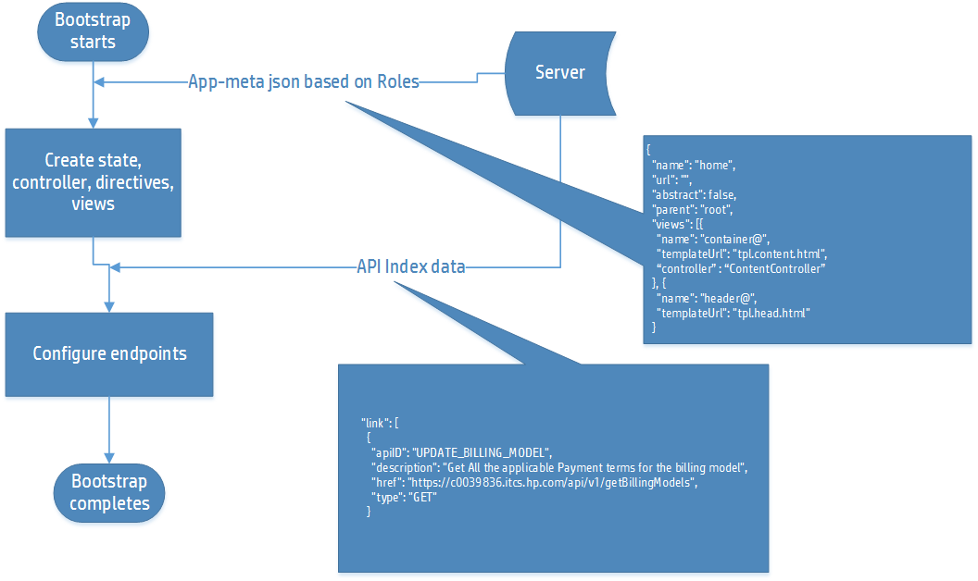
Predictive Approach

